Slide 1

Capstone Project User Experience Workflow Design – UIUX Design for System Modelling
UX Analysis

Slide 2
Part A

Slide 3
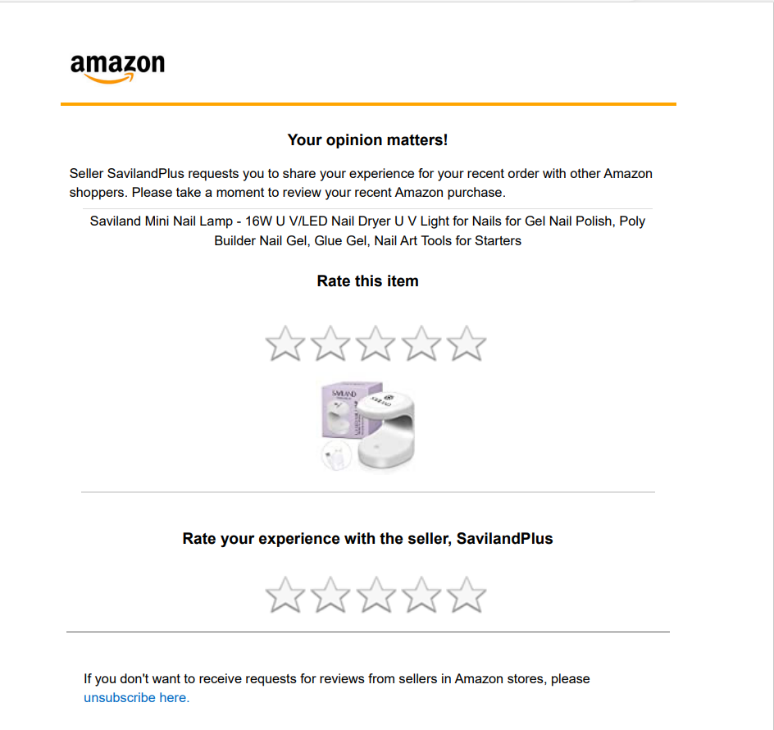
Enhancing Customer Connections: The Power of Feedback
The business problem/goal described here is to create a better connection with customers by addressing their complaints and feedback through a post-purchase feedback email:

Slide 4











Stakeholders to involve
Customer Support Team
Data/BA/BI Analysts
Service Improvement Team
Product & Design Development Team
Sales & Marketing
Management & Leadership
Customers
IT/Technical Team
Legal & Compliance
Logistics/Operations
Quality Assurance Team

Slide 5
Timely Response
Aim for Timely Responses and Adequately Trained Customer Support Team:
Amazon should strive to address customer feedback and issues as soon as possible. Responses should ideally be given within 24 to 48 hours to show that you are concerned about your customers' needs.
The customer support team should have enough staff and be properly trained to deal with various types of complaints in order to guarantee prompt responses, Investing in training enhances the quality of responses and resolution times.
Prompt responses contribute to better customer satisfaction and loyalty.
The stakeholders involved in this process should be Customer Support Team, Management & Leadership, IT/Technical Team and Quality Assurance Tea
Example: Customers who buy a smartphone from Amazon and complains about the camera. Within 24 hours, the customer support team responds, apologizing for the inconvenience and offering troubleshooting advice. If the problem continues, they also offer a replacement or a refund.

Slide 6
Personalisation
Respond personally to each customer's feedback:
Customize your responses to address the particular good or service the customer purchased as well as their specific complaint.
Personalization demonstrates the value and attention given to each customer's opinions.
Automated systems with human interaction
Automated systems can be used to add customer-specific details to responses.
To connect with customers, keep your language and tone friendly and sympathetic.
Example: A customer mentions in their feedback that a kitchen appliance they bought had a dent when it arrived. The response from Amazon's customer service acknowledges the specific product, offers their condolences for the inconvenience, and makes arrangements for the prompt shipment of a replacement.

Slide 7
Quality Assurance
Well-Trained Customer Support Team:
A skilled customer support team can handle various complaints and inquiries efficiently.
Regular training ensures they are equipped to provide satisfactory resolutions.
Regular Quality Checks
Implement regular performance evaluations to assess the team's adherence to service level standards.
Continuous improvement in customer support leads to better experiences.
Example: A customer contacts Amazon with a complex technical issue related to a smart home device they bought. The customer support representative, well-trained in troubleshooting such devices, patiently guides the customer through the process, eventually resolving the issue and ensuring the customer is satisfied.

Slide 8
Data Analysis
Extracting Insights from Feedback:
Implement a robust data analysis process to extract valuable insights from customer feedback.
Utilize tools like sentiment analysis and categorization to identify recurring issues.
Prioritizing Improvement Areas
Analyze feedback data to identify critical areas that require immediate attention and improvement.
Data-driven decisions lead to targeted enhancements.
Example: Amazon gathers feedback on a newly launched electronic gadget. After analyzing the data, they discover that many customers are reporting a common software glitch. This insight prompts the product development team to release a firmware update, addressing the issue and improving the product's performance.

Slide 9
Continuous Improvement
Collaboration Across Departments:
Share feedback insights with product development, service improvement, and marketing teams.
Collaboration fosters continuous improvement efforts.
Showing Value in Customer Feedback
Demonstrate to customers that their feedback is valued and acted upon.
Communicate updates and improvements to customers to enhance transparency
Example: Based on customer feedback, Amazon's clothing department realizes that some customers find their sizing inconsistent. They work with manufacturers to standardize the sizing and update product descriptions to provide clearer size guidelines.
Involvement of Stakeholders:

Slide 10
Involvement of Stakeholders
Open Communication Channels:
Foster open communication between customer support and other departments.
Regular feedback sharing enhances cross-functional understanding.
Stakeholder Meetings
Organize regular meetings involving stakeholders from different teams.
Discuss feedback trends and strategize on improvement initiatives collectively.
Example: The customer support team holds regular meetings with product managers, sharing feedback about a specific line of laptops. They collaborate on identifying areas for improvement, leading to better product performance and customer satisfaction.
Technical Implementation:

Slide 11
Technical Implementation
IT/Technical Team's Role:
The IT team plays a crucial role in setting up the automated feedback email system.
Ensure customer data security and reliability in sending automated emails.
Example: Amazon sets up an automated email system that sends personalized feedback requests to customers after each purchase. The system ensures that customers receive emails tailored to the specific products they bought.

Slide 12
Marketing Utilization
Leverage Positive Feedback:
Use positive feedback and resolutions as testimonials and success stories in marketing materials.
Showcase the company's customer-centric approach.
Example: A customer gives positive feedback about the quick delivery of a gift they purchased from Amazon for a special occasion. The marketing team features this feedback in social media posts and email newsletters, showcasing Amazon's commitment to timely delivery.

Slide 13
Management Oversight
Active Monitoring:
Top-level management should actively monitor the feedback handling process.
Regularly assess the progress and effectiveness of the initiative.
Resource and Support Allocation
Provide necessary resources and support to ensure the success of the feedback initiative.
Management involvement is crucial for a customer-focused culture.
Example: Amazon's top management reviews customer satisfaction metrics regularly. They notice a decline in ratings for a particular category of products and initiate a cross-functional meeting to address the underlying issues promptly.

Slide 14
SWOT Analysis – Strengths
Strong Customer Reach:
Amazon's vast customer base and extensive online presence provide a significant opportunity to collect valuable feedback from a large number of customers.
Automated Feedback System:
Amazon's capability to automatically send feedback emails after purchases streamlines the process and ensures that customers are consistently engaged.
Data Analytics Capabilities:
Amazon's proficiency in data analysis enables them to extract meaningful insights from the feedback data, identifying patterns and trends in customer complaints.
Established Customer Support Team:
Amazon's experienced customer support team can efficiently handle and respond to customer complaints, demonstrating a commitment to resolving issues promptly.

Slide 15
SWOT Analysis - Weaknesses
Scale of Feedback Management:
The high volume of customer feedback received can be overwhelming, making it challenging to respond individually to each customer effectively.
Potential Lack of Personalization:
Automated feedback emails may lack a personal touch, leading to potential concerns about the authenticity of responses.

Slide 16
SWOT Analysis - Opportunities:
Enhanced Customer Engagement:
By actively responding to customer complaints and feedback, Amazon can build stronger connections and foster a sense of trust and loyalty among its customers.
Continuous Service Improvement:
Valuable feedback insights can help Amazon identify areas for improvement and make data-driven decisions to enhance products and services continually.
Upselling and Cross-Selling:
Feedback interactions can be leveraged to recommend relevant products or services, increasing the chances of upselling and cross-selling opportunities.

Slide 17
SWOT Analysis - Threats
Competitor Responsiveness:
If competitors have more agile feedback response systems, customers may be enticed to switch their loyalty.
Negative Feedback Amplification:
Failure to address negative feedback promptly can lead to dissatisfied customers sharing their experiences online, potentially damaging Amazon's reputation.
Privacy and Data Security Concerns:
Collecting and managing customer data for feedback purposes may raise privacy and data security concerns, necessitating compliance with relevant regulations.

Slide 18
Conclusion
By focusing on these aspects and involving the relevant stakeholders, Amazon can create a customer-centric approach that addresses complaints and feedback effectively, leading to stronger customer connections, improved brand loyalty, and a reputation as a company that genuinely cares about its customers.
These examples demonstrate how Amazon can effectively address customer feedback, leverage data insights for improvement, and involve various stakeholders to create a seamless and customer-centric experience. By implementing these strategies, Amazon can build stronger connections with its customers and strengthen its position in the competitive market.
Based on this SWOT analysis, Amazon can leverage its strengths in customer reach, automation, and data analytics to effectively address the business problem/goal. By identifying opportunities for enhanced engagement and service improvement, while mitigating potential threats through proactive feedback management, Amazon can foster a stronger connection with its customers and maintain its reputation as a customer-centric organization.

Slide 19
Part B

Slide 20
